Slide 1

Capstone Project: Final Presentation
Gavin Grooms
Tufts University, Spring 2024

Slide 2
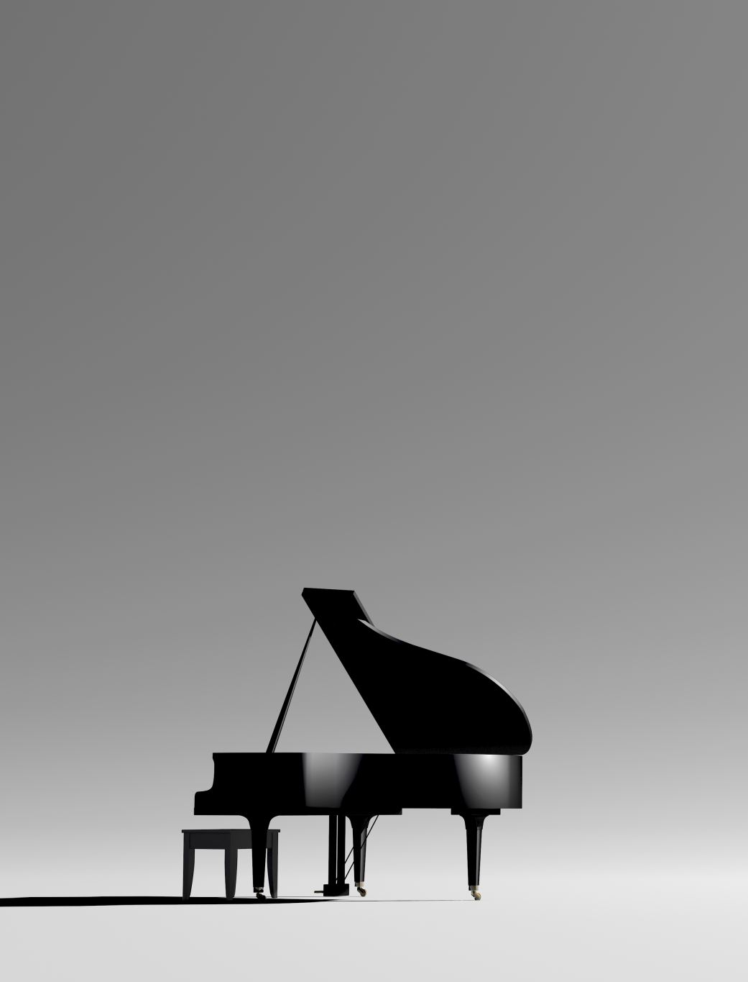
What is the problem?
In the music industry, students and individuals looking to make personal recordings for auditions or other endeavors must either hire an accompanist, fit their tuning and style to computerized recordings, or play without accompaniment.
Authentic, well-tuned accompaniment is expensive, whether that’s through a human accompanist or advanced computer tuning.
A pianist can cost around $60/hour for human accompaniment.
Auto-tune software usually involves tuning the human user and not the accompaniment, leading to an inauthentic performance. This is generally unacceptable outside of popular music.
Performing with a recording forces a soloist to forgo their individual interpretation of a piece.

Slide 3
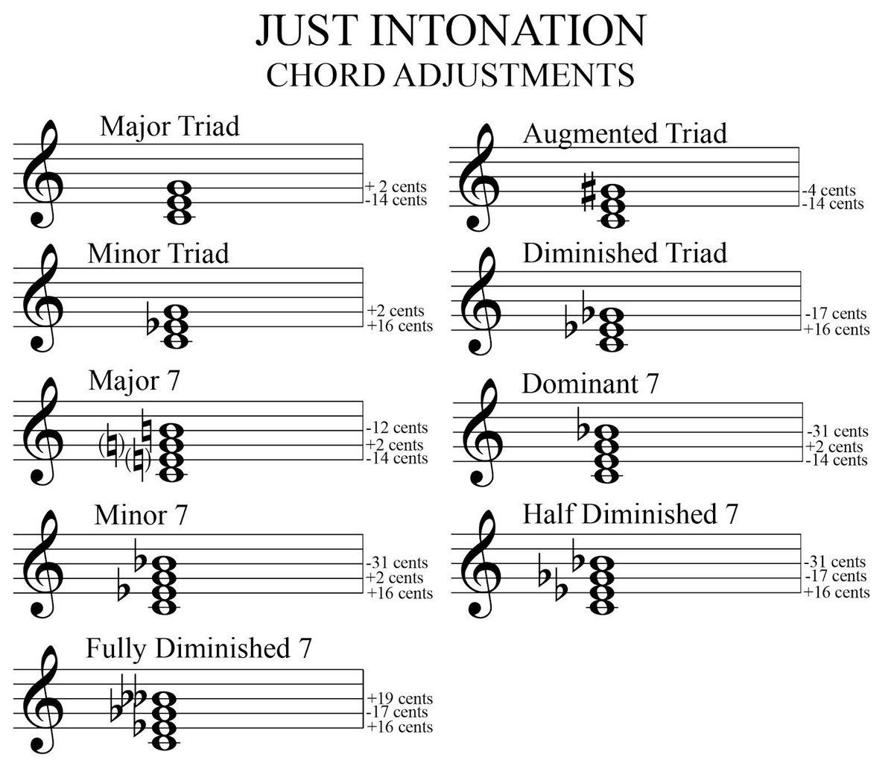
Why not tune the user?
In professional orchestras, everyone listens to and tunes their instruments to a single source of truth: an oboist or a solo musician in the case of a concerto/aria performance.
Just intonation is natural and is not the same as equal temperament. Musicians are encouraged to listen closely to each other to achieve perfect, natural harmonies.
This is generally considered infeasible for a piano (and by extension, MIDI instruments) due to the inability to retune notes in the middle of a performance.

Slide 4
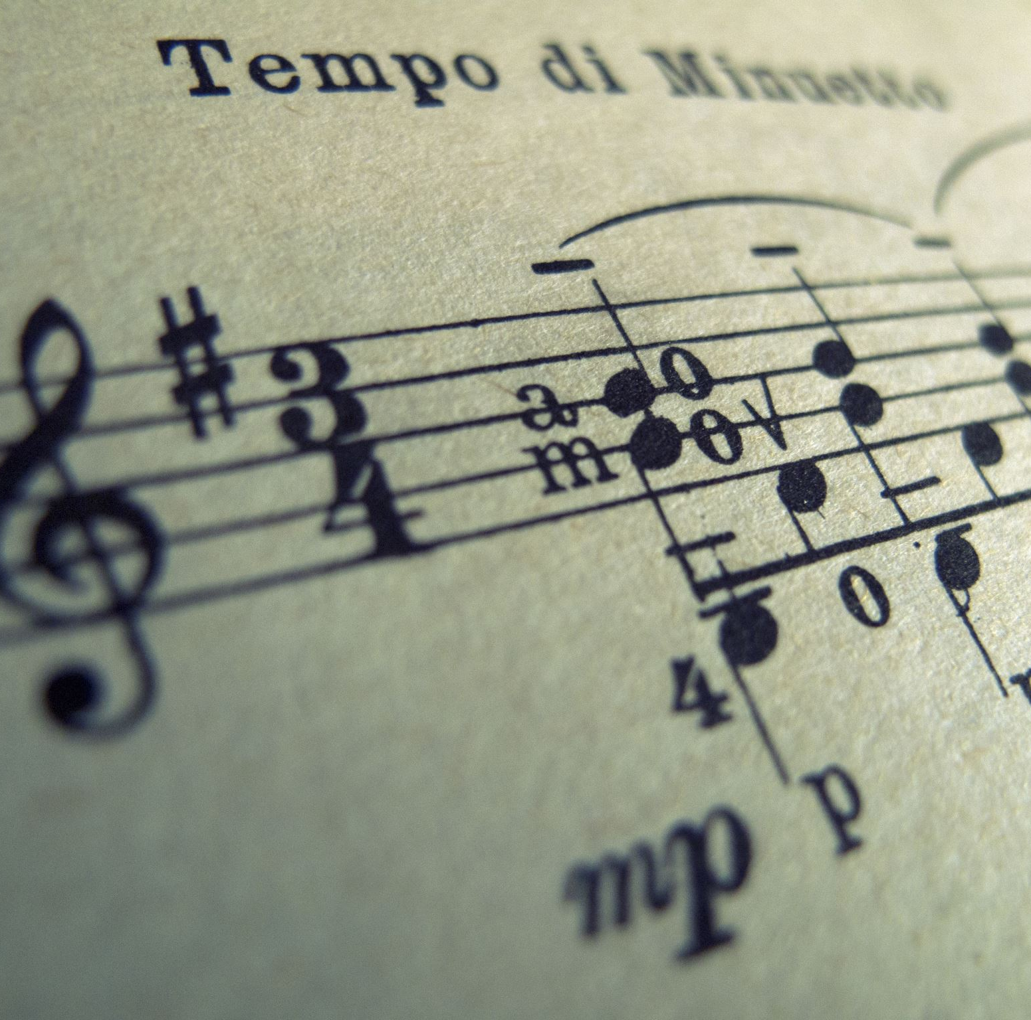
My Solution
We know exactly what frequencies produce perfect harmonies, so all we need to do is identify where those harmonies are in the music.
My project reads a MIDI file and streams it out to an audio file format with natural harmonies.
Naïve analysis is performed on all individual notes in the MIDI file to determine whether clear harmonies exist.
Notes that are identified as belonging to a chord have their output frequencies adjusted to align with natural tuning.

Slide 5
DEMO

Slide 6
Potential Impact
My program allows young musicians to have access to well-tuned computer accompaniment that can better suit their needs.
My program challenges the computer music industry to avoid settling on equal temperament intonation as being “good enough” for the music world.

Slide 7
Valuable Coursework at Tufts
CS 121 – Software Engineering
This course inspired me to tackle this project in smaller incremental tasks and spend the time to plan out how the implementation would work. It also helped me learn to test all along the way to ensure each portion worked correctly.
CS 160 – Algorithms
Dynamic Programming was a methodology I kept in mind when designing the process for identifying notes and how they’re related to each other.
CS 170 – Computation Theory
My project consists of many separate time-consuming steps. I worked to reduce the time complexity of each step to avoid code that runs slowly in O(n^2) time.
CS 135 – Machine Learning
While I was unable to gather the data necessary for a tuning analysis model, I know that such a model is feasible and would greatly improve the tuning analysis in my project.

Slide 8
Lessons Learned
I learned a lot about the importance of planning and designing when building a larger scale project. I saved a lot of time and trouble due to already having a solid plan for the execution of my goals.
I learned a lot about interacting with new software libraries that I have never used before. Most of the ones in this project have very little support outside of a limited documentation site, which left a lot of initial questions unanswered.

Slide 9
Things I wish I did differently
I wish I had a better tone-generating library to use in place of Nsound. While Nsound was very helpful, I always felt held back by the limited API and documentation for it.
I wish I had spent more time investigating other programming languages to use in place of Python. While Python works well, the execution of my program is slow. Adding future phases will slow down the end result significantly.

Slide 10
Things I learned about Engineers
Software Engineers do a LOT more than just write code! I spent way more time planning and testing my project than I did writing code in Python.
It’s critical to be able to prove to my peers and superiors that a solution works. It is not enough to just verbally assure them it does, you must convince them.

